Slide 1

ICT PPT ACTIVITY
ACTIVITY 1
presentation by: Carl Paris

Slide 2
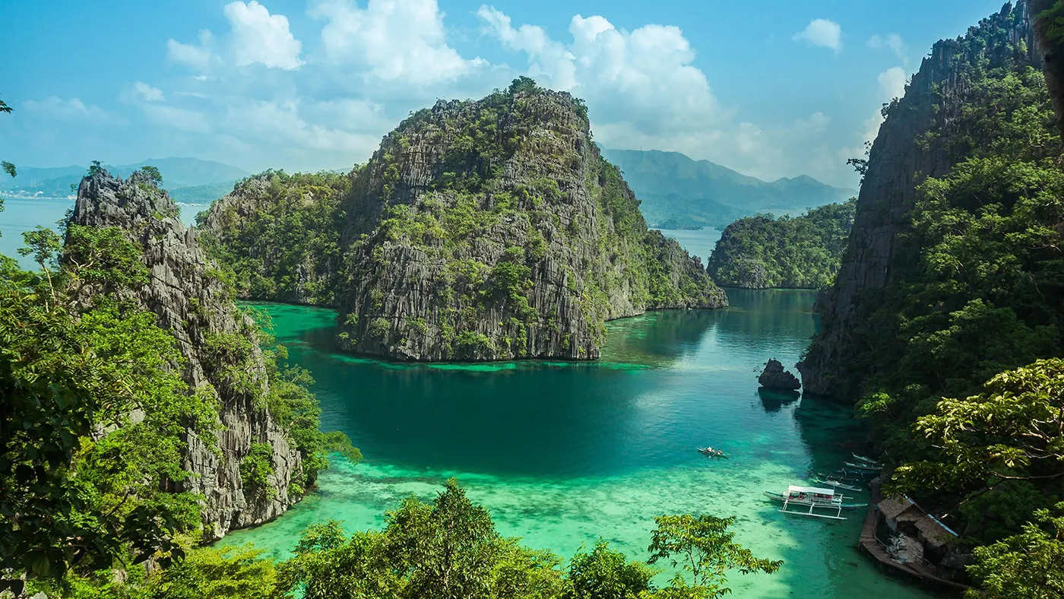
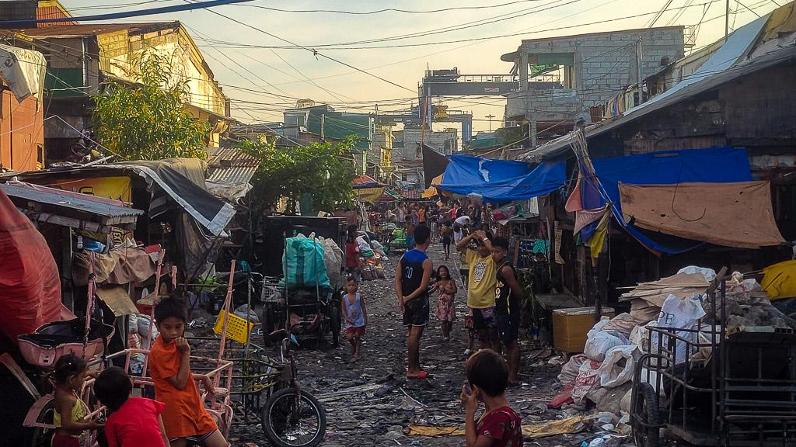
welcome to the
#lovethephilippines

Slide 3
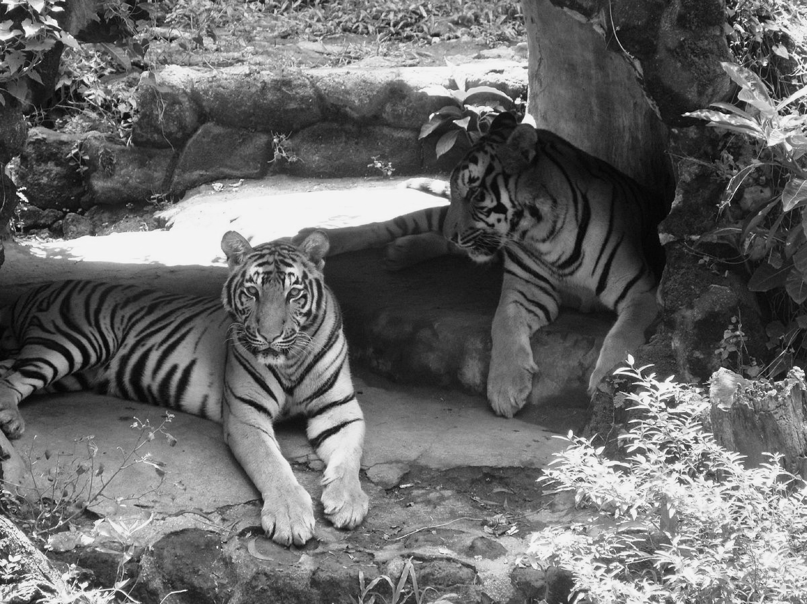
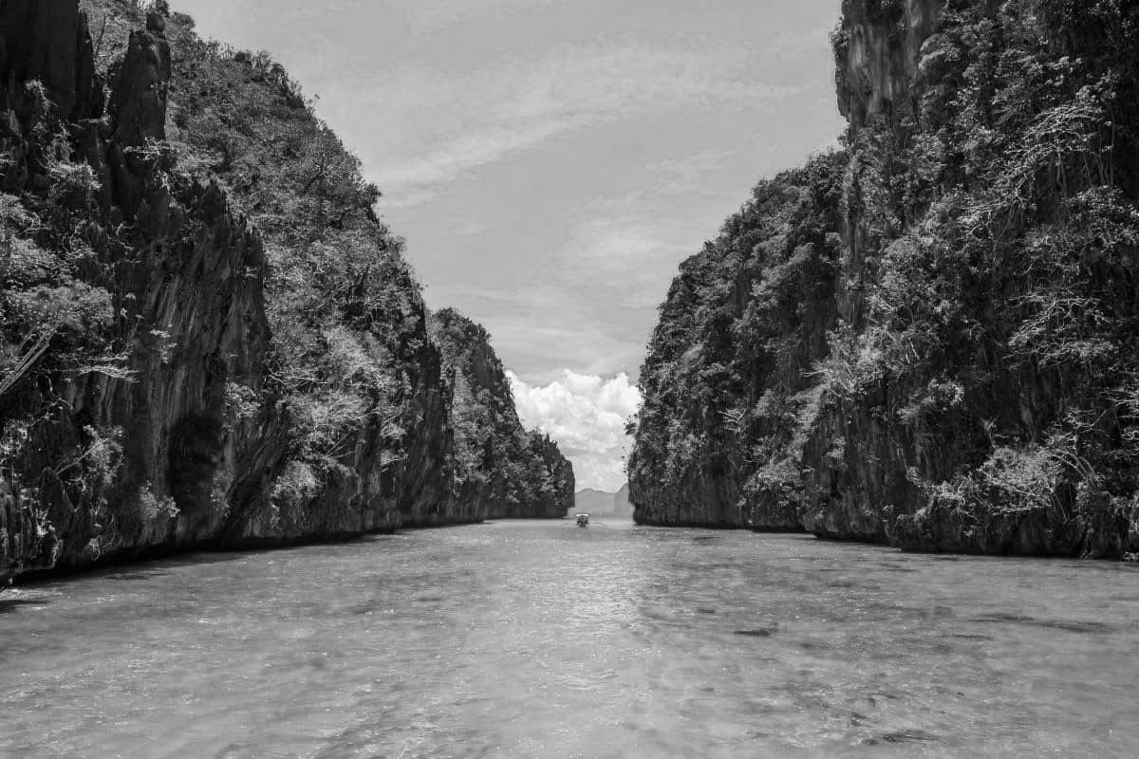
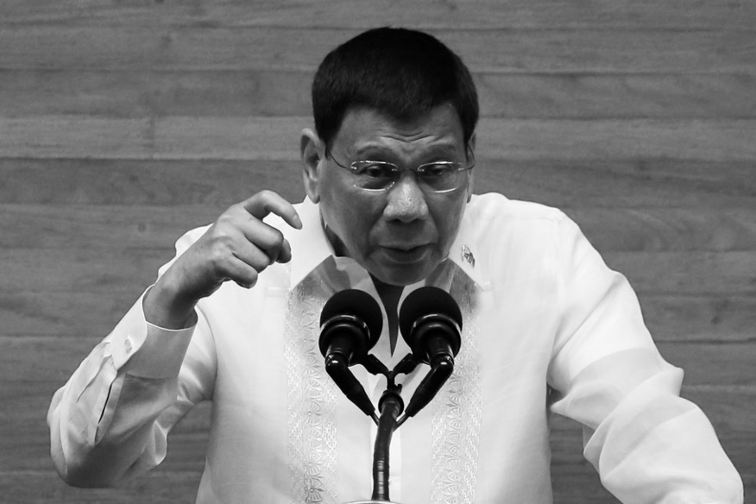
what do you want to see?
1
2
3
animals
attractions
politicians

Slide 4
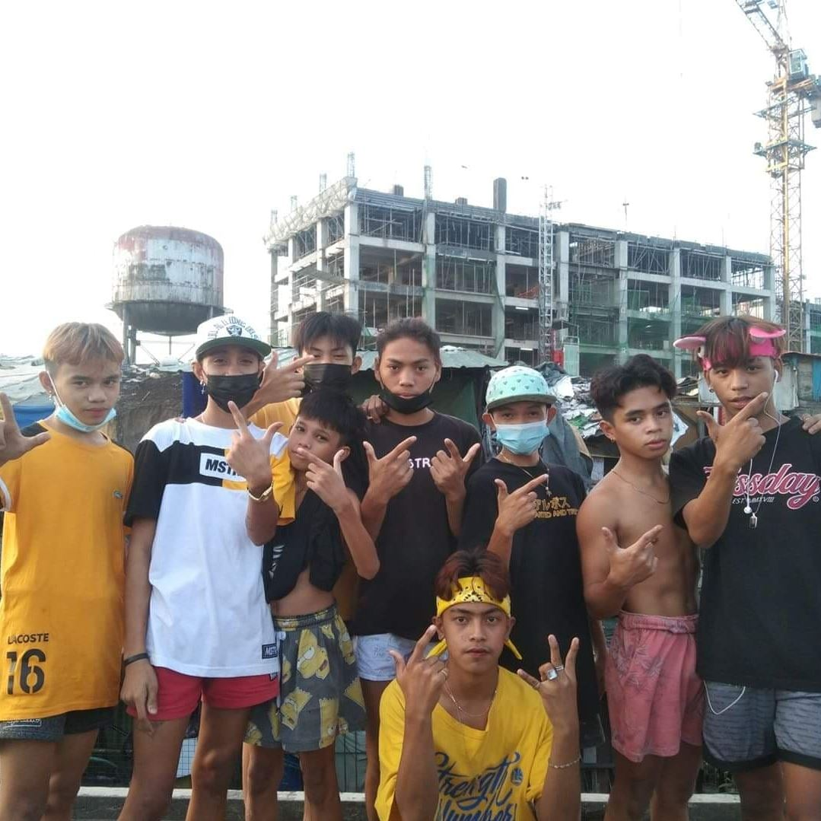
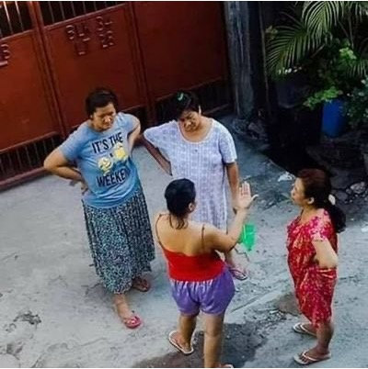
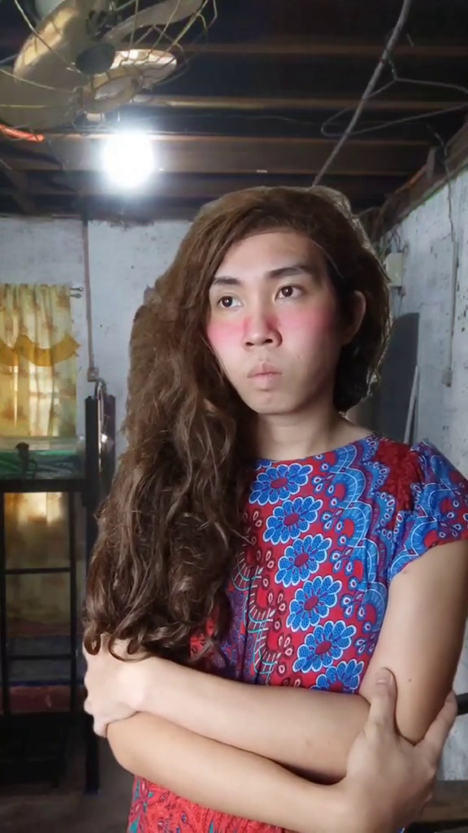
our exotic animals
geng geng
marites
cracklings
“feeling cool kids”
“data analysts”
“maasim”

Slide 5
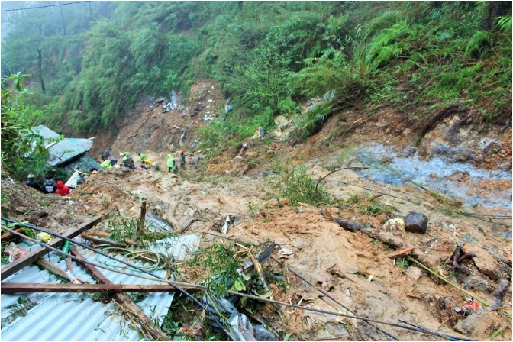
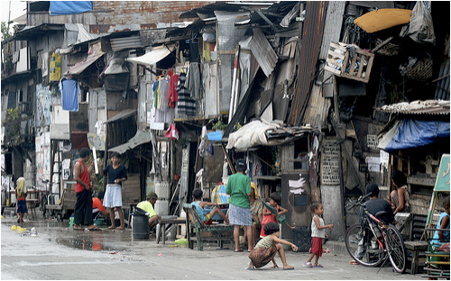
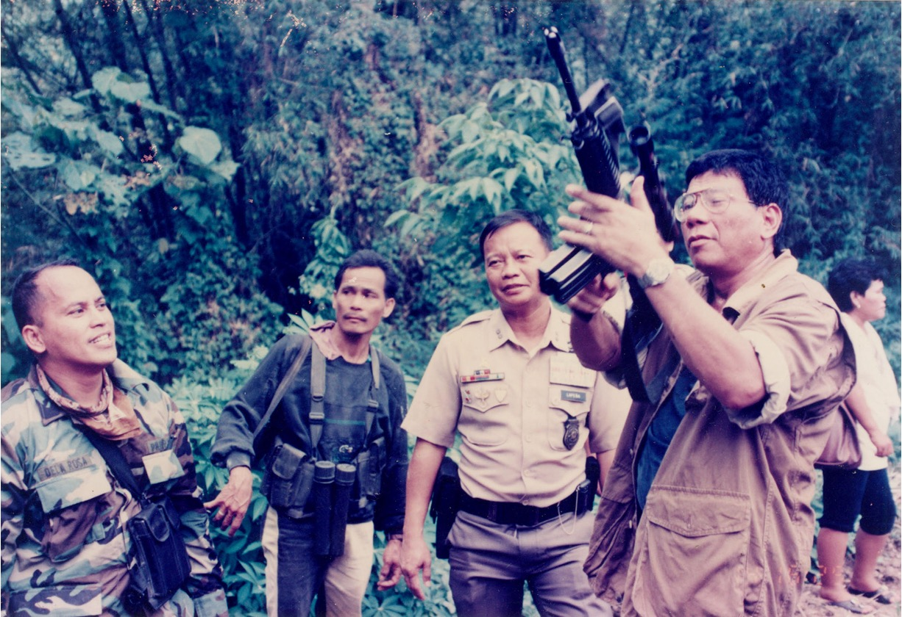
our beautiful attractions
Baguio City
Manila
Davao City
“beautiful nature with cold climate”
“city of the rich”
“very peaceful”

Slide 6
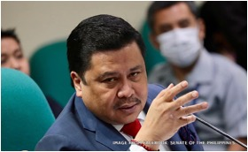
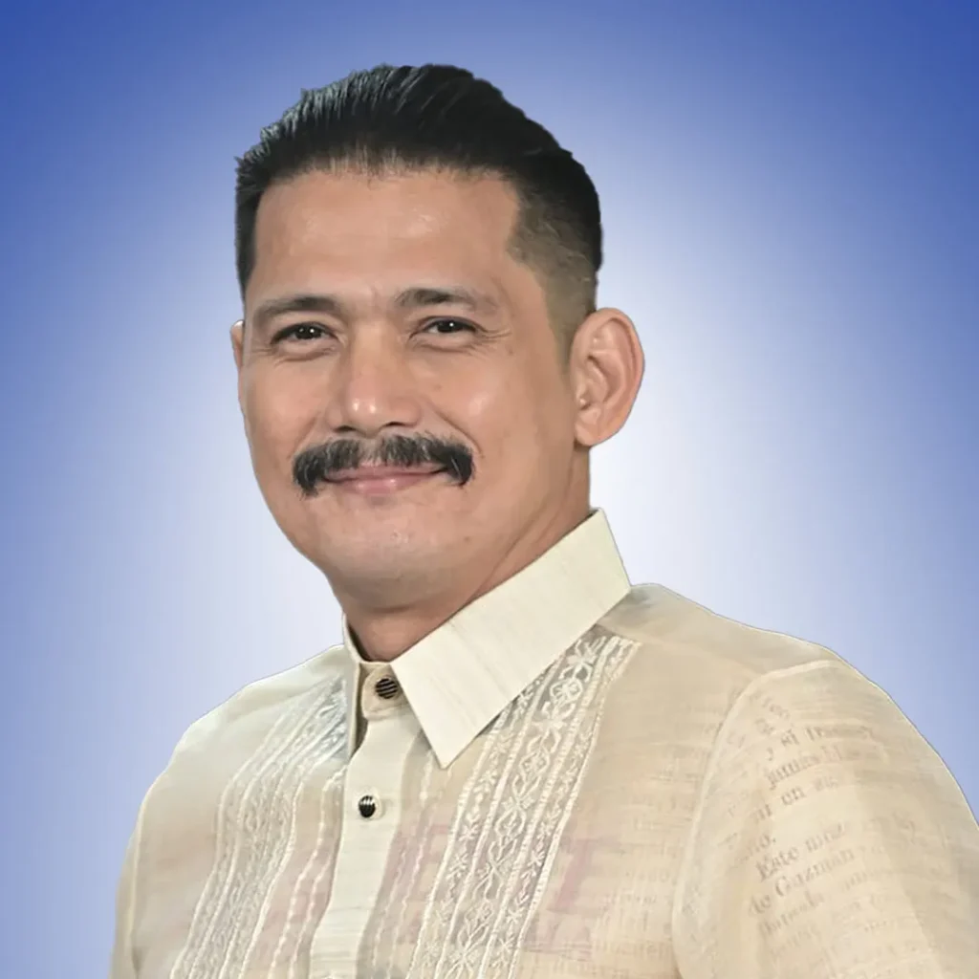
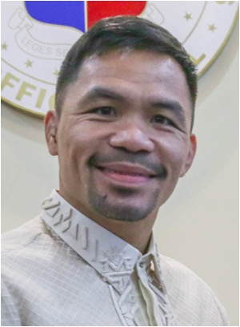
our steaming politicians
Senator
Senator
Senator
Jinggoy Estrada
Robin Padilla
Manny Paquiao
Charged with plunder and graft
Movie Star
Boxer
“Pork Barrel Scam”
“In Heat”
”Pambansang Kamao”

Slide 7
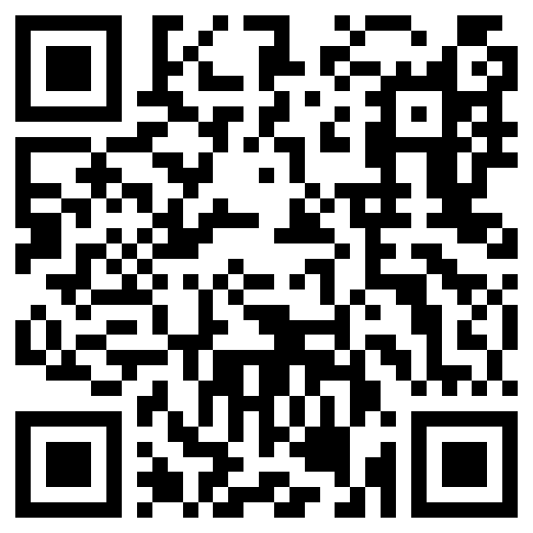
to learn more of our beautiful country, click here!
or scan the QR code provided at the side.

Slide 8

Did you try opening the link or the QR code? Please try!
it actually works!

Slide 9
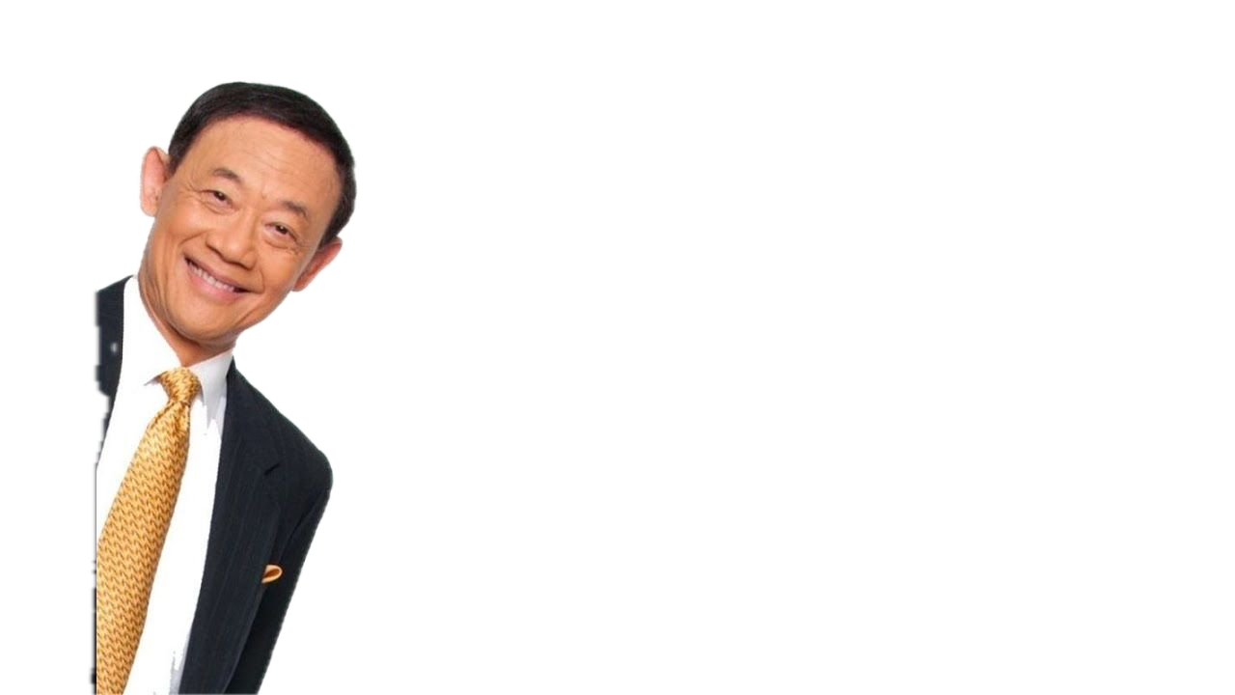
Okay, that’s it

Slide 10
Okay, that’s it

Slide 11
Bye bye!
#lovethephilippines

